Slide 1
Bot-thoven: A Musical Robot Performer
Senior Research Project
David Cha (and Jason Pak)

Slide 2
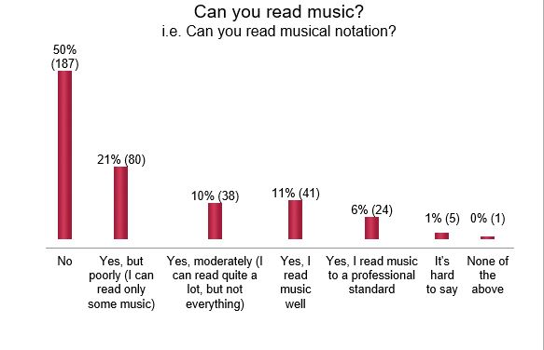
Motivation
War on music
Over-emphasis on STEM
5/7 SRGS
16/18 VA Governor’s Schools
Decline in music literacy/interest

Slide 3
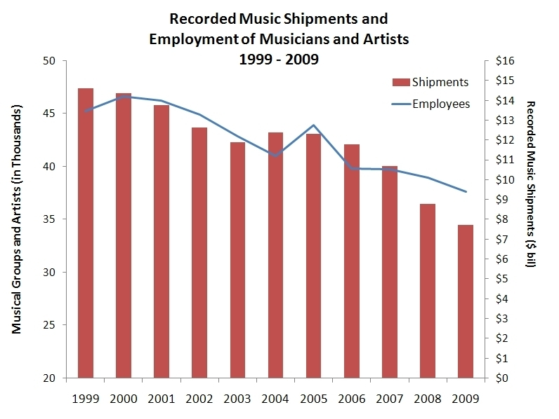
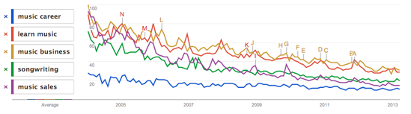
Motivation cont.

Slide 4
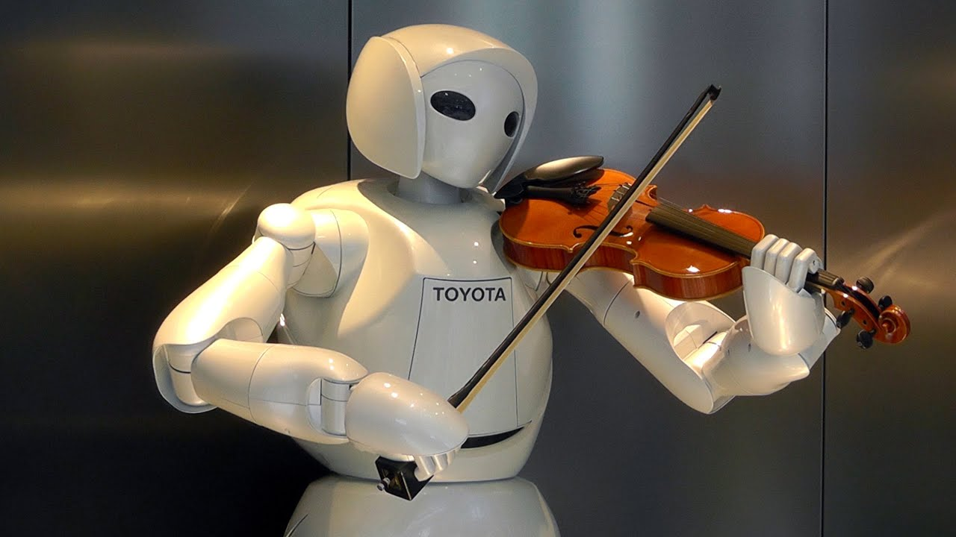
Motivation cont.
Current instrument-playing robots demonstrate impressive technicality
Yet lacks musicality found in human performers
Human performers use techniques such as:
Dynamics (loud vs. soft)
Articulation (clarity of sound)

Slide 5


Proposal
Our proposal is to build a robot that can play music MUSICALLY, using Arduino and Python programming, in order to foster a newfound interest in music and improve the quality of robotic musicians.

